Slide 1
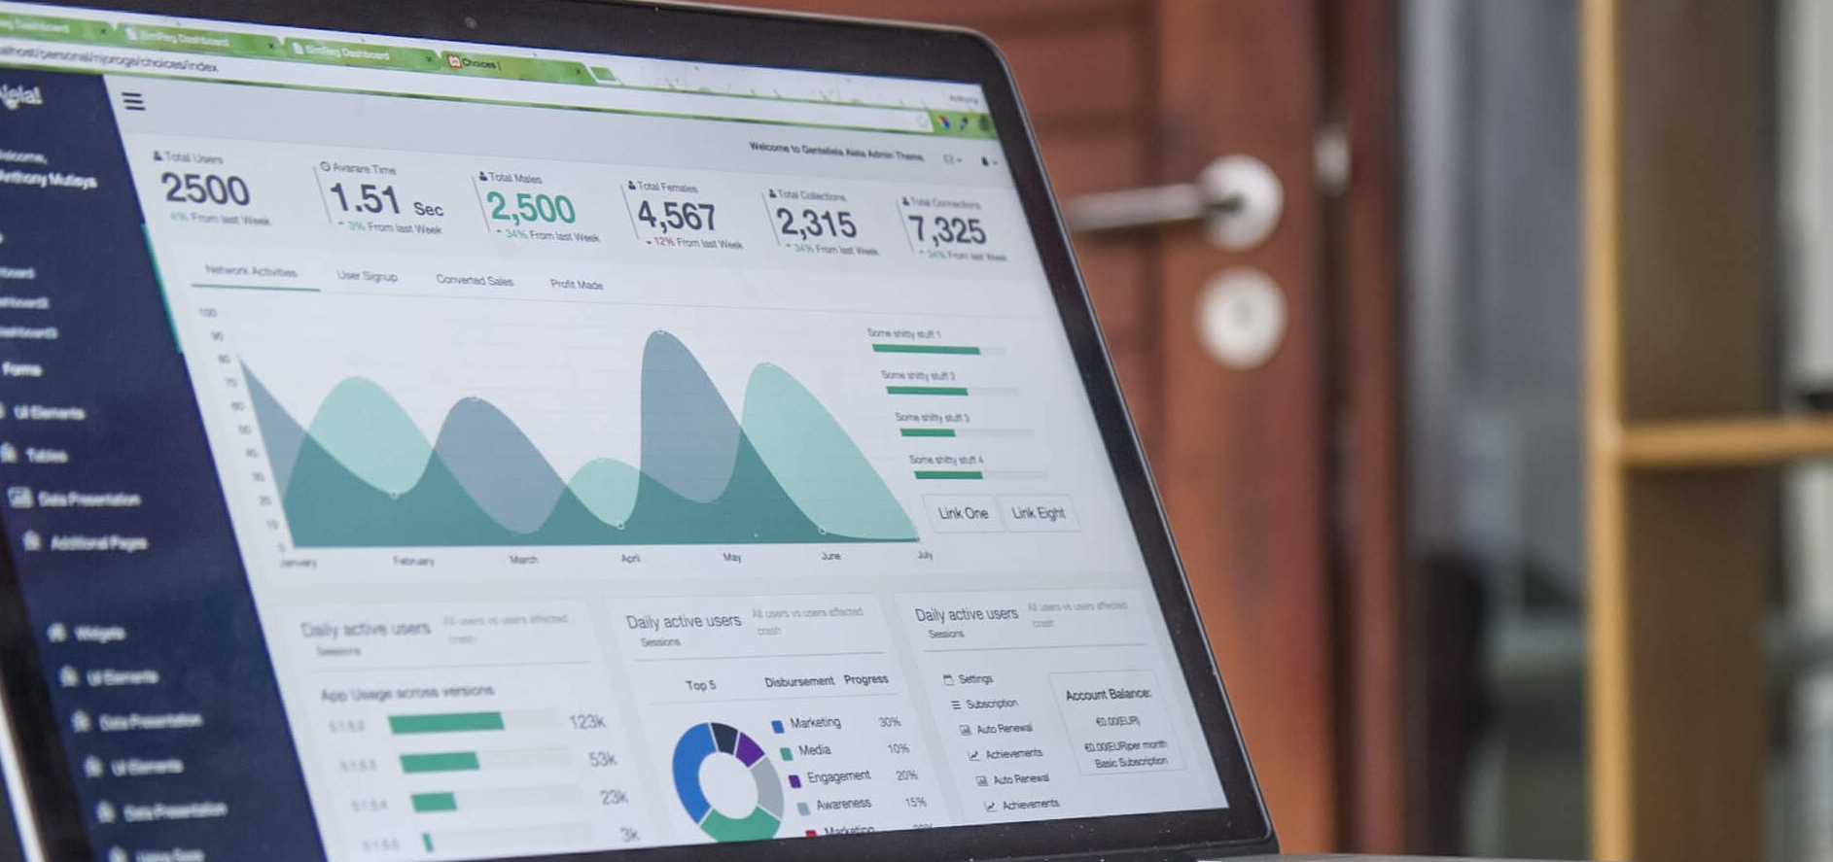
Internship Insights Analytics Dashboard
Rynixsoft Internship – Sprint 3
Presented By
Shama Anjum S
Notes:
Photo by Carlos Muza on Unsplash

Slide 2



Sprint 1 -Recap
Synthetic Dataset Creation using Python (Google Colab)
Cleaned Dataset (missing values ,duplicates)
Real-time system using Flask (Add/Delete/Edit intern records)
Data stored in Excel for further analysis
Notes:
Photo by Carlos Muza on Unsplash

Slide 3
Sprint 2 –Exploratory Data Analysis
Notes:
Photo by Carlos Muza on Unsplash

Slide 4

What is EDA ?
✔ Helps understand data structure ✔ Identifies trends and patterns ✔ Detects errors or inconsistencies ✔ Supports better decision-making
Notes:
Photo by Carlos Muza on Unsplash

Slide 5
What is EDA ?
✔ Helps understand data structure ✔ Identifies trends and patterns ✔ Detects errors or inconsistencies ✔ Supports better decision-making
Notes:
Photo by Carlos Muza on Unsplash

Slide 6
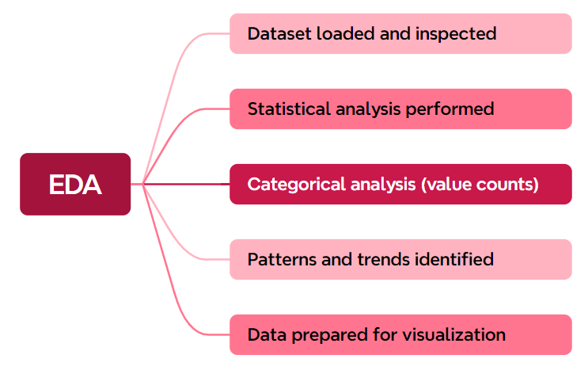
EDA Process
Notes:
Photo by Carlos Muza on Unsplash

Slide 7
KEY INSIGHTS
Top Department: Data Science Identified using value_counts() to find highest frequency
Average Attendance: 84.72% Calculated using mean() on attendance data
At-Risk Interns: 72 Identified using conditions:
Attendance < 75%
Task Completion < 60%
Rating ≤ 2
High Performers: 37 Interns Based on Performance_Level (rating ≥ 4)
Avg Productivity Score: 82.18 Calculated using weighted formula:
Task Completion (50%)
Attendance (30%)
Performance Rating (20%)
Notes:
Photo by Carlos Muza on Unsplash

Slide 8
FEATURE ENHANCEMENT
Performance Level Categorized based on rating:
High (≥ 4)
Medium (3)
Low (≤ 2)
Task Completion (%) Calculated using: Tasks Completed / Tasks Assigned
Risk Status Identified using conditions:
Low Attendance (<75%)
Low Task Completion (<60%)
Low Rating (≤ 2)
Productivity Score Calculated using weighted formula:
Task Completion (50%)
Attendance (30%)
Rating (20%)
Productivity Level Classified based on score:
High
Medium
Low
Notes:
Photo by Carlos Muza on Unsplash

Slide 9
Visualization using PowerBI
Notes:
Photo by Carlos Muza on Unsplash

Slide 10
Thank You !

